Slide 1
Short Bytes
Graduation and Completion Rates

Slide 2
Overview
Graduation Rate and Completion Rate are cohort-based calculations
Based upon students in a school/district with the same Anticipated Year of Graduation (AYG)
Graduation Rate – reflects students who have been counted as a graduate
May include students who have been counted as a graduate and return to participate in a Postsecondary Program (ASCENT, P-TECH, TREP) or Special Education 18-21 Transition services
When students are returning for Postsecondary Programs or 18-21 Transition services, the graduation date listed on their high school diploma/transcripts will reflect the point they complete their program/services, which may differ from the year in which they were counted as a graduate.
HB17-1294, HB17-1194, HB19-1066, SB21-185
Completion Rate – reflects students who have been counted as a graduate and students who are other high school completers or have received their HSED

Slide 3
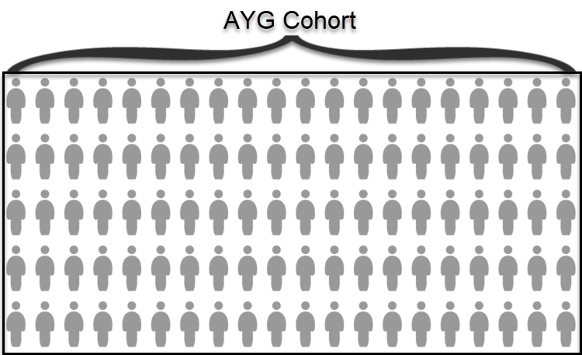
AYG Cohort
All students with the same AYG assignment in a group (state/district/school)
AYG Cohort initially built based upon students entering 9th grade
Transfers in are added to the AYG cohort
Verified transfers out are removed from the AYG Cohort
Requires adequate documentation of transfer
Exit Types: 02, 05, 13, 14, 15, 16
Serves as the graduation base (denominator) in graduation and completion rate calculations

Slide 4
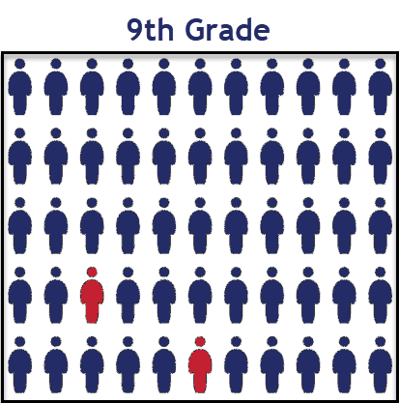
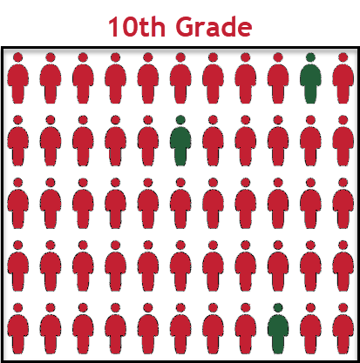
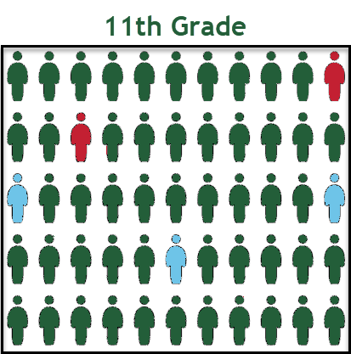
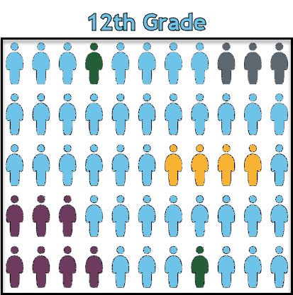
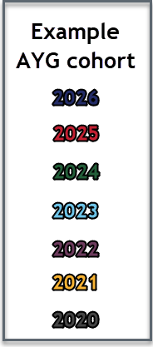
AYG represented in High School Population
Once a student is assigned an AYG, that AYG remains constant.
Students who experience grade reassignments (acceleration or retention) remain in their original AYG cohort.

Slide 5
Graduation Rate
Graduate
Graduation Rate
A student who exits high school with a regular high school diploma. (School Exit types 90, 95, 96)
Locally defined graduation requirements
Colorado Graduation Guidelines
AYG 2021 and beyond
Graduation Guidelines Menu of Options
At least one Reading/Writing/Communicating (English) measure
At least one Mathematics (Math) measure
Number of AYG cohort members graduated (Exit Types 90, 95, 96)
÷
Number of students in the AYG cohort

Slide 6
Completion Rate
Completer
Completion Rate
Completers are student’s who meet locally defined criteria for completing high school, but not graduating
School Exit Type 92
Receive a non-diploma certificate of completion (locally defined certificate of completion, attendance, achievement)
Complete a vocational program
Are accepted into an institution of higher education to pursue a bachelor’s or associate’s degree without receiving a high school diploma
School Exit Types 93 or 94
HSED recipient
Number of AYG cohort members graduated or completed (Exit Types 90-96)
÷
Number of students in the AYG cohort

Slide 7
Extended Graduation/Completion Rates
AYG Cohort remains the same (+ transfers in and - minus verified transfers out)
4-year rates includes all students who graduate/complete within 4 years of entering high school, including students who graduate/complete early
Sometimes called ‘on-time’ graduation rate
Extended Graduation and Completion rates include all students who graduated/completed in a previous year and the students who newly graduated in the given year (5-, 6-, 7-years)

Slide 8
Instructional Program Service Type (IPST) categories
Graduation/Completion rates use cohort based IPST categories
Students who belong to one or more of the following categories at some point during their high school career are placed into the IPST cohort for that given category
Students with Disabilities
English Learners
Economically Disadvantaged
Migrant
Title 1
Homeless
Gifted and Talented
Foster
Military Connected
A student does not need to belong to the IPST category in all four years of high school to be considered part of the IPST cohort

Slide 9
Data Validation Highlights
Students may only be counted as a graduate or completer in once year and in one school
Many business rules in the SEY collection help support counting students only once
Students belong to the AYG cohort of the last school they attend in Colorado unless they have a school exit type that indicates they are a ‘verified transfer out’ of the school
See the document ‘Exit Types that Comprise the AYG Cohort’ posted on the SEY website.
Students who are indicated as transferring to another CO Public school (school exit type 13) that are not reported by another CO public school within the school year (school entry date after the school exit date indicating transfer out of district) must be recoded as dropped out during the SEY collection IF the district does not have adequate documentation to support the use of school exit type 13
These students remain in the AYG cohort of the school coding them as dropped out (school exit type 40)
Special coding patterns exist for students participating in postsecondary programs (ASCENT, P-TECH, TREP) and Special Education 18-21 Transition Services to support counting these students as graduates at the point they have met local and state graduation requirements while still allowing them to return to participate in the Postsecondary Program or Transition services

Slide 10
More Information: Student End of Year Website Graduation/Completion Statistics Website Graduation Guidelines Website

