Slide 1
Kindergarten School Readiness
August 2023
Notes:
Welcome and introduction—type in chat name, role, district
Some content on slides, but we will pause, discuss, and talk through questions throughout each section
Share with audio

Slide 2
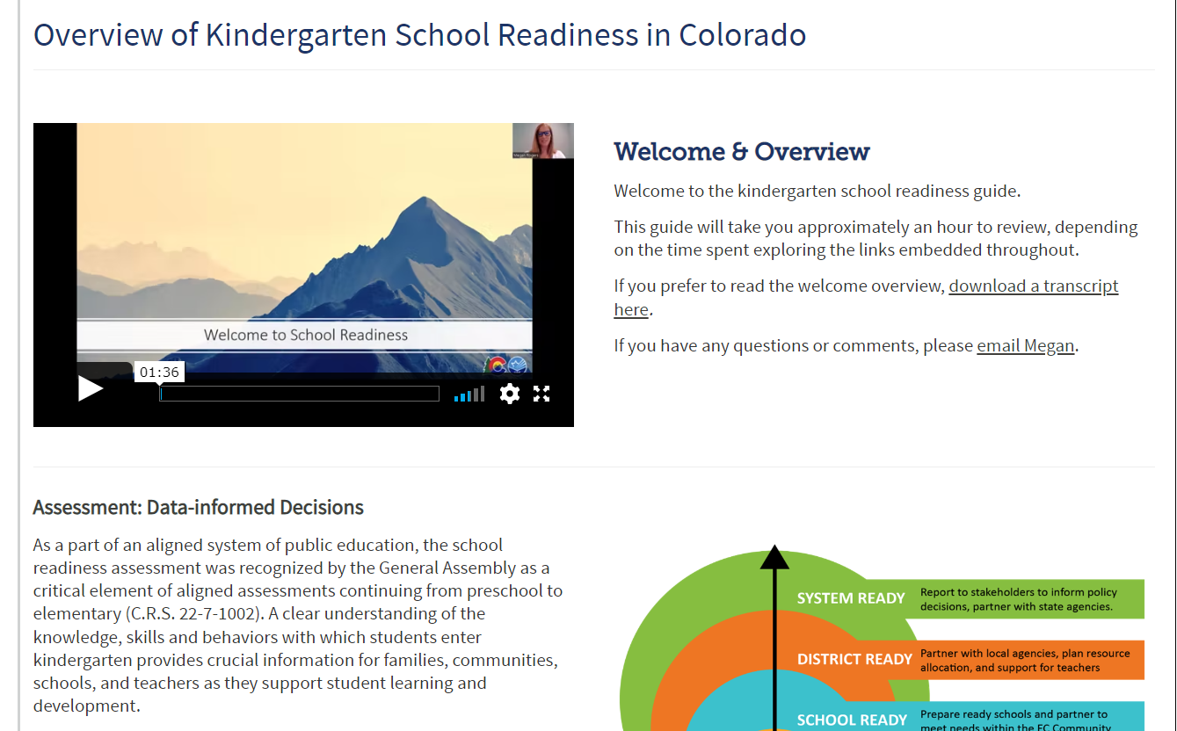
Agenda KSR Guide Key Ideas Discussion Questions
Notes:
Agenda: https://www.cde.state.co.us/schoolreadiness/ksrguide
We will follow the sections in the guide as a way to work through content
Each section: Discuss key ideas and answer any questions
Goal for today: Deepen understanding of School Readiness and discuss ways to support this initiative locally

Slide 3
Ready Child
School readiness describes both the preparedness of a child to engage in and benefit from learning experiences, and the ability of a school to meet the needs of all students enrolled in publicly funded kindergarten. School readiness is enhanced when schools, families, and community service providers work collaboratively to ensure that every child is ready for higher levels of learning in academic content.
~State Board of Education, 2023
Ready System
Notes:
In Colorado:
The School readiness description is adopted by the SBE
Big idea:
To strengthen the preparedness of schools and the local system in being ready to meet the needs of each child and their family
Through partnerships within the community
Through collaboration, shared leadership, and make data informed decisions addressing local community needs
This is the big picture of school readiness. Let’s look at this from a different view

Slide 4
Overview of School Readiness
Data-informed decisions at the classroom, school, district, and state level
Class: data-informed instruction and intervention
School and district: informed decisions on instruction, resources, and community partnerships.
State: informed policy decisions, state agency partnerships
Notes:
This image might be familiar from the guide—depicting these levels or layers of support around the individual child
The kindergarten school readiness assessment tools fit into the big picture here by:
measuring students’ readiness to engage with the curricula in kindergarten and by identifying baseline data to inform systematic intervention and additional layers of instructional support (Jensen)
1) Let’s look at this from the Class level: the primary purpose of the KSR assessment tools are to inform instruction and intervention in the classroom, to have access to meaningful information on students, and use this to make data-informed decisions.
2) Schools and Districts may also use the KSR/assessment tools along with other early elementary assessments to identify trends across multiple data sources and across student data over time. Analysis of trends over time can aide schools and districts in identifying partnerships within the community to continue to support child and families prior to K and as they enter elementary.
3) State: this data is reported annually in the CAP4K legislative report: https://www.cde.state.co.us/sites/default/files/docs/cdedepcom/2023%20CAP4K%20Legislative%20Report%202.13.23.pdf

Slide 5
Kindergarten Assessment
Notes:
Video Transcript: Watch online https://www.youtube.com/watch?v=skgP7isEsqg&t=2s

Slide 6
Key Responsibilities
Schools and districts serving publicly funded students in kindergarten
Use state board-approved assessment tools.
Assess six domains of learning and development in school readiness.
Administer the KSR assessment from 1st day of school through the first 60 calendar days.
Create individual learning plans (school readiness or K plans) for each student.
Report data during the KSR data collection window.
Notes:
School readiness is legislated through CAP4K/Preschool to post secondary educational alignment act
KEYs:
Alignment: standards and assessment
Specific to school readiness, learning and development
Responsibilities: See chart in guide
The path or process to preparing schools ready to meet the needs of each student and students ready to engage is flexible, which allows for local decision-making that addresses current community needs and reflects the goals stemming from family and community partnerships

Slide 7
Why School Readiness
Brain Science: How brains are built and the impact of trauma
Child Ready, System Ready
Whole Child, Is There a Half? Understanding the relationship between learning and development
The Kindergarten Balance: Meeting the needs of every child
Authentic Assessment
Notes:
School readiness statute is unique:
Reflects how brains are built
Holistic learning and development
Supports the uniqueness each K brings into school
Currently some approved KSR assessments are observation-based assessments, others are not
Pause: Choose 1 area of interest and 1 resource to review: https://www.cde.state.co.us/schoolreadiness/ksrguide-why

Slide 8
Kindergarten School Readiness Assessment
Child Ready: Students ready to engage
State Board Approved Assessments aligned to CAS/ELDGs
Required domains of learning and development
physical well-being and motor development,
social and emotional development,
language and comprehension development,
cognition,
literacy, and
math.
School Ready: Schools ready to meet the needs of each student
Analyze child data for trends and inform local system goals and partnerships
Notes:
Link to approved assessments: https://www.cde.state.co.us/schoolreadiness/assessment#srassessmentmenu
Child: all publicly funded Kindergartners are to be assessed, including students who are homeschooled, attend school online and in charter schools.
Literacy: If the Interim READ assessment is administered within the first 60 days, this may be used to inform or replace the literacy domain
When making decisions: consider purpose of assessment and consider what is assessed
School:
Early Learning needs assessment
Vendors
Pause for questions

Slide 9
Assess and Instruct
Administer the KSR Assessment from the 1st day of school through the first 60 calendar days.
Using the kindergarten assessment data to drive instruction is achieved through data-based decision making.
This is documented in Individual Learning Plans (School Readiness or K Plans)
Notes:
The purpose of the KSR assessment tools are to inform instruction and intervention.
Using data from KSR assessment tools to drive instruction is achieved through data-based decision making
ODM is one model for individual problem-solving and data-based decision making
The process of assessing, identifying needs and setting goals, and monitoring progress toward those goals that is captured in the individual learning plan
Individual learning plans are required for all publicly funded K’s, just like the assessment
READ Plan is to be a component of SR Plan, if required
Many additional resources online to support individual learning plans
Pause for questions

Slide 10
KSR Data Collection
KSR data is reported to CDE each fall during the KSR Data Collection.
Data file layout is approved by the State Board of Education
Some vendors provide a Colorado specific report
Get to know your KSR data respondent
Notes:
2023 Data collection window: October 4th _ December 5th
Aggregate data is reported for all publicly funded kindergarten students, including students who are homeschooled, attend school online and in charter schools.
Tip: Know who your data respondent is and work together to identify a process to transfer data
Link to file layout: https://www.cde.state.co.us/schoolreadiness/kindergartenschoolreadinessdatacollection
Some assessment tools will create a Colorado specific report, other assessments do not. We are currently in conversations with the newly approved assessment vendors to support Colorado specific reporting based on the interest of that vendor to do so.
Pause for questions

Slide 11
2022 Aggregate Data
Notes:
Aggregate Data from Fall of 2022 (last school year) as reported in the CAP4K Report in Feb. 2023

Slide 12
Timeline
Summer May-August
Planning
Beginning of School (August-Sept)
Assessment Window: first 60 days
Provide assessment support
Monitor vendor platforms
Finalize scores
KSR Collection Window (Oct-Nov)
Ensure data respondent has the KSR file layout
Develop Individual Learning Plans
Mid- and End-of-year assessment
Communicate dates for mid- and end-of-year assessment windows
Communicate domains to assess
Plan for transitions
Licenses
Review Assessment Options
Notes:
Difference this year—if your school or district is reviewing additional assessment options, this may need additional time.

Slide 13
Reminder of Key Responsibilities
Schools and districts serving publicly funded students in kindergarten
Use state board-approved assessment tools.
Assess six domains of learning and development in school readiness.
Administer the KSR assessment from 1st day of school through the first 60 calendar days.
Create individual learning plans (school readiness or K plans) for each student.
Report data during the KSR data collection window.
Notes:
Summary:
Orient to the School Readiness webpages: https://www.cde.state.co.us/schoolreadiness

Slide 14
Office Hours Time: 12:30-1:00 Fall Dates: September 14th, September 28th, and October 12th Link located on the School Readiness Training and Meeting Webpage
Notes:
Office hours are an informal time for questions and discussion throughout the fall.
Generally, we will focus discussion on the time period we are in—there may be a few reminders
Calendy link for 1 on 1 discussions: https://calendly.com/rogers_m/30-minute-meeting

