Slide 1

Arts Instructional Unit Samples
Webinar
April 21, 2014
http://www.cde.state.co.us/standardsandinstruction/instructionalunitsamples

Slide 2
By the End of this Webinar…
Take Aways:
Become familiar with the depth and breadth of the arts unit resources
Understand the unique “Points of Interest” about the arts units
Determine possible uses for the arts units
Give email feedback for next webinar topics
What we will not cover in this webinar:
  Standardized Assessments
  Educator Effectiveness

Slide 3
B.I.G. Project Goals
Standards and Instructional Support
  Curriculum Samples and Unit Development
Build deeper understanding of the CAS and how to translate standards to focused curriculum planning
Increase capacity to create and continuously improve curriculum based on the CAS
Gather feedback regarding the process and the products associated with Colorado’s District Sample Curriculum Project-Unit Development Phase

Slide 4
Overall Goal
To create a unit that provides teachers with support for using their professional judgment to teach to student mastery of the standards-based generalizations, content, and skills included in one unit overview.

Slide 5
Project Overview
Lesson Plans will be the work of individual schools and teachers.
Lesson Plan
Standards
Lesson Plan
Sample Unit Development
Lesson Plan
Unit Overview
Year At A Glance
(page 1)

Slide 6
Curriculum
An organized plan of instruction that engages students in mastering the standards
Curriculum provides a road map for instruction
Standards
Textbooks
Resources
Instructional Materials

Slide 7
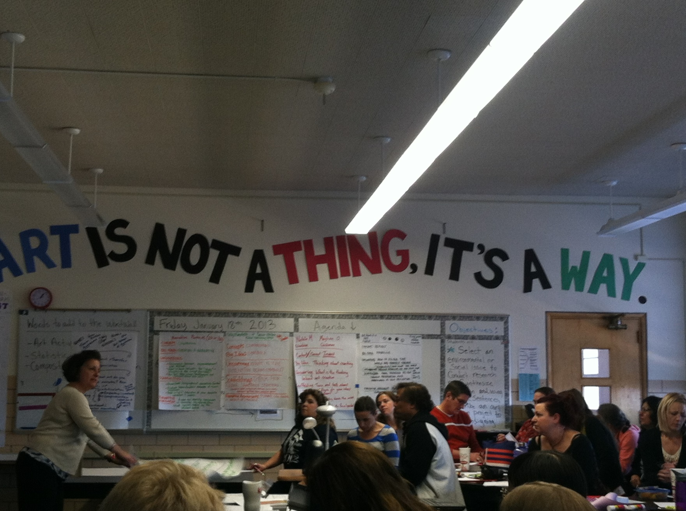

Slide 8
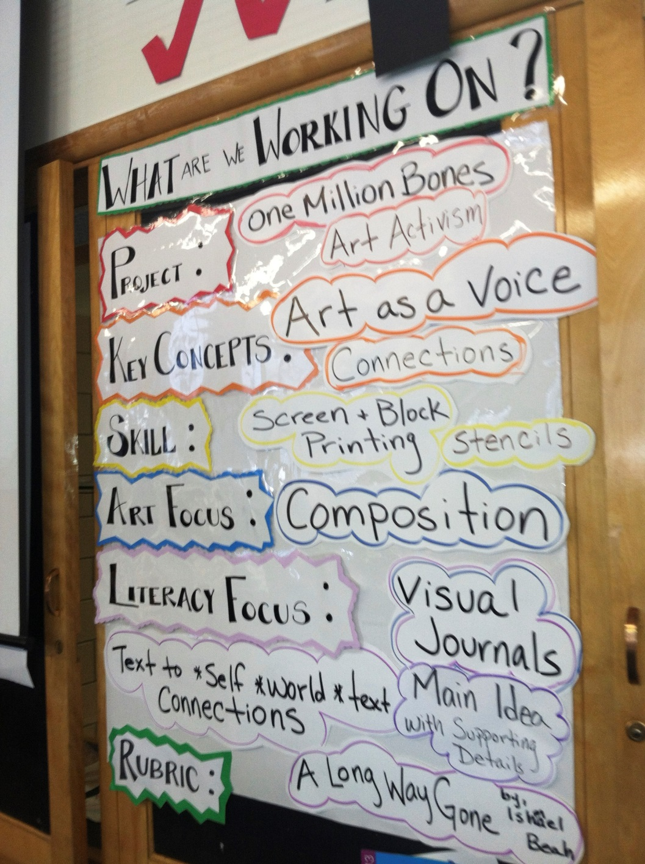

Slide 9
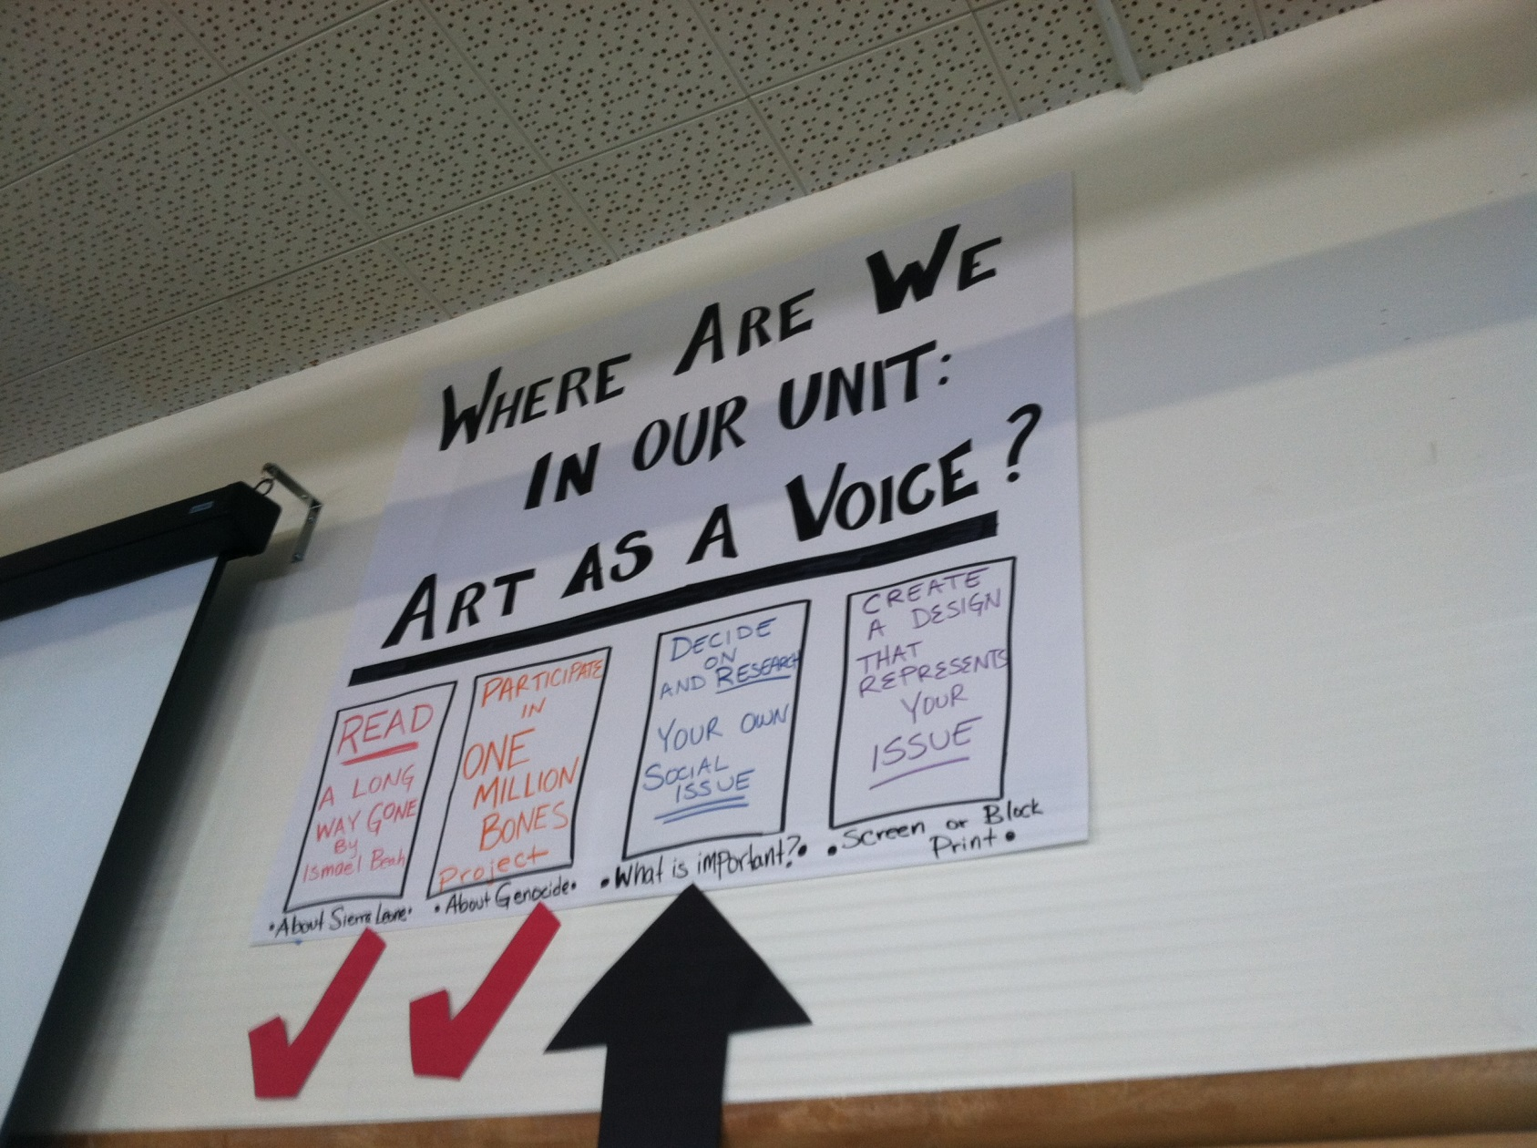

Slide 10
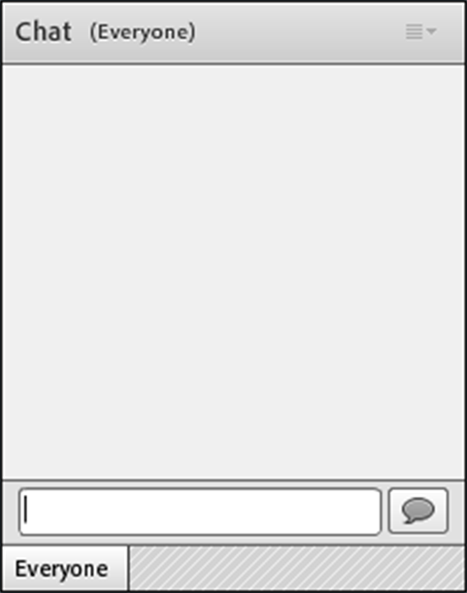
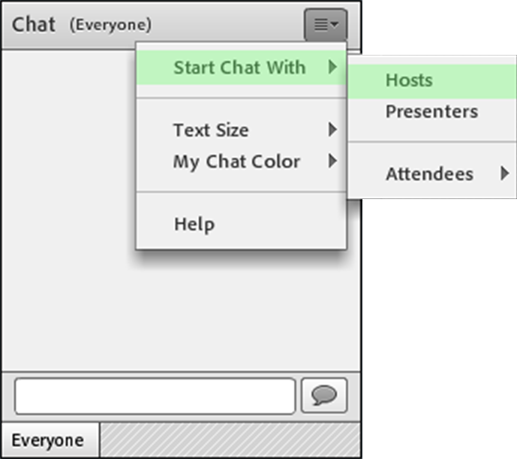
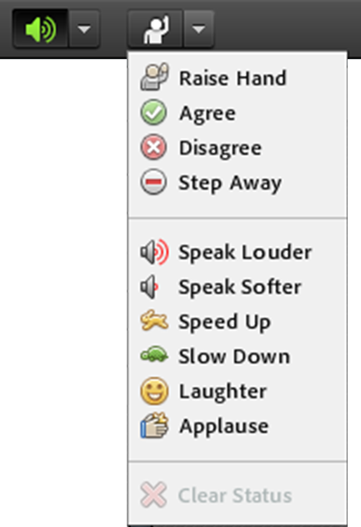
Navigating Adobe Connect
Use top audience participation drop down menu to add icons
For a private Chat, choose person you want to contact in attendee list
Use Chat to share, respond to questions and ask questions

Slide 11
Use poll window
“Who is joining us today?”
  Please click the appropriate response so we can get an idea of who is with us today
    Role
    Art Discipline/Specialty
    Grade level

Slide 12
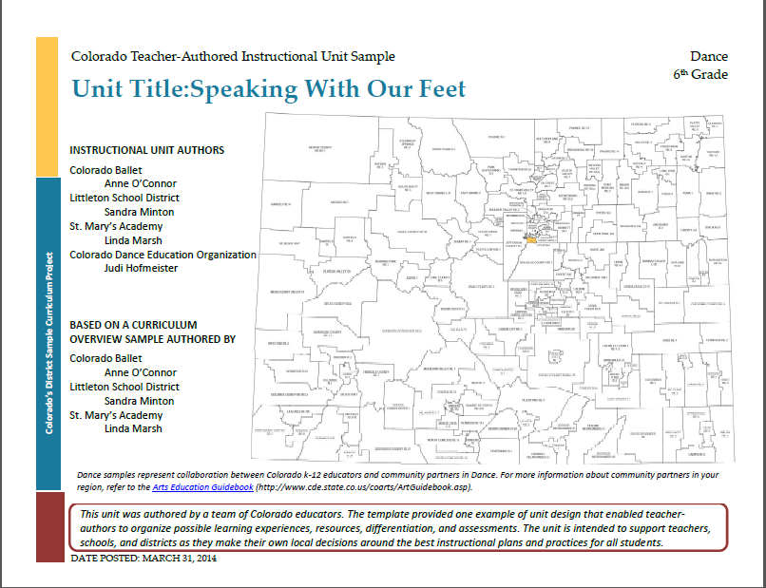
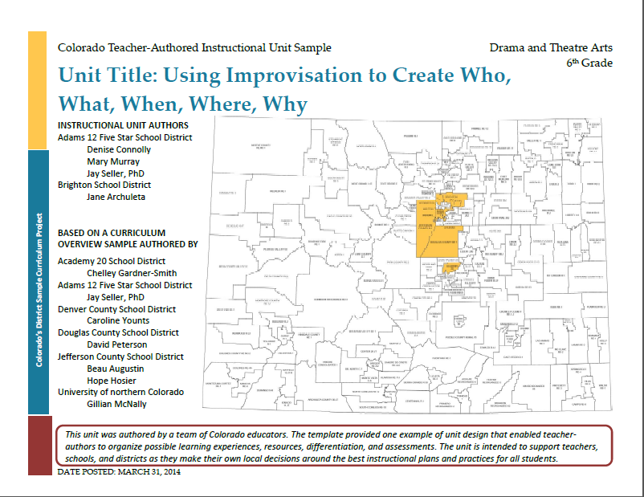
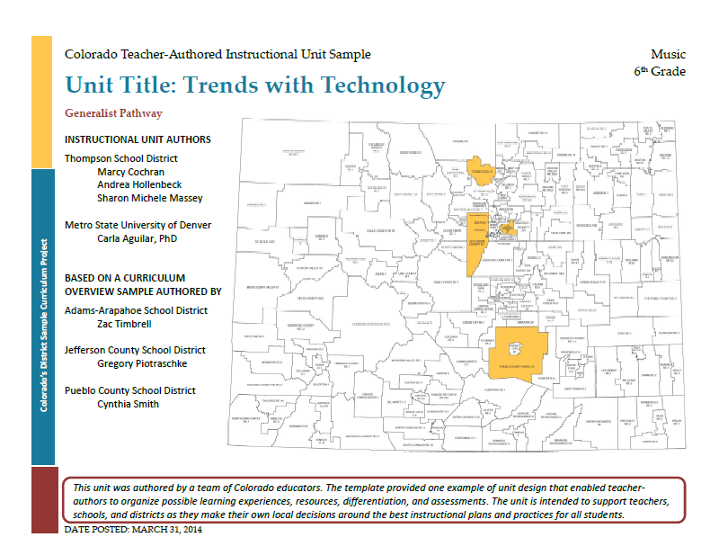
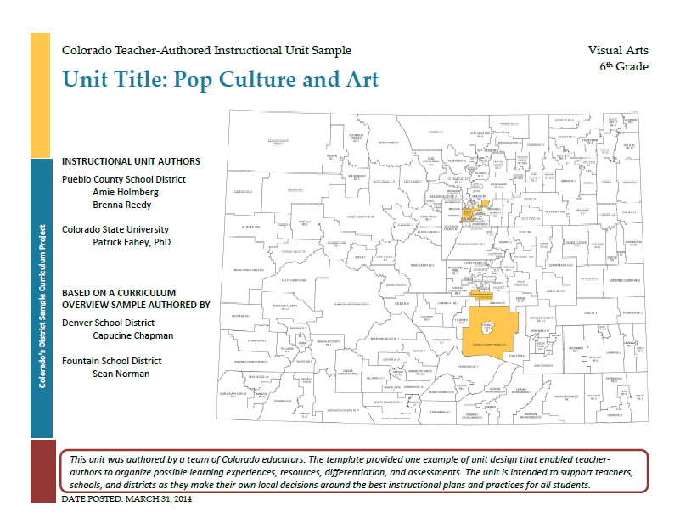
“Document Tour”

Slide 13
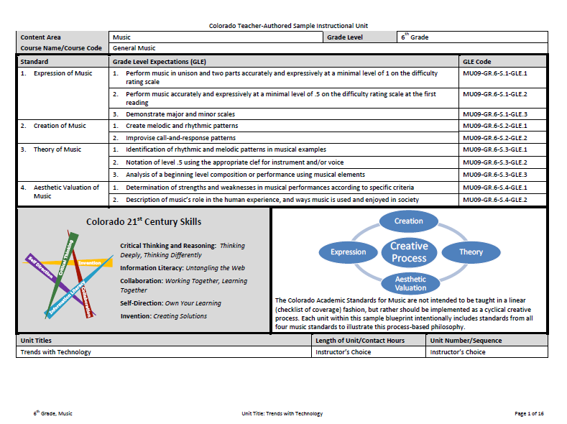
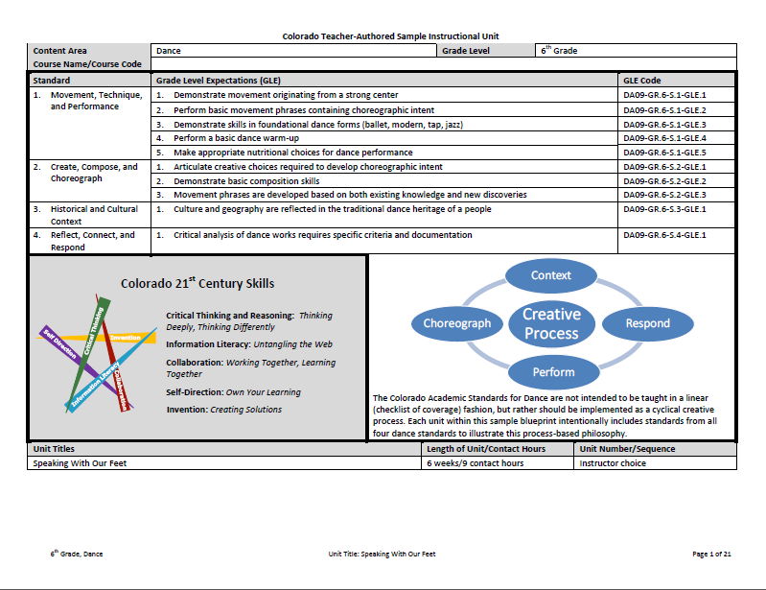
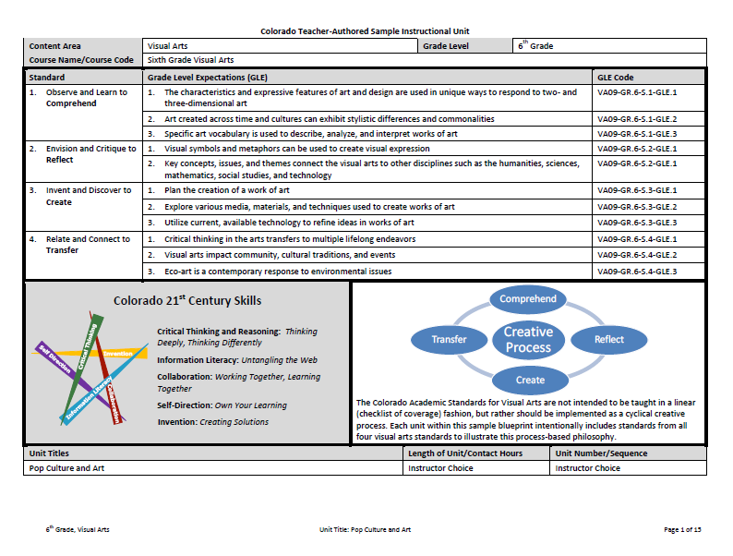
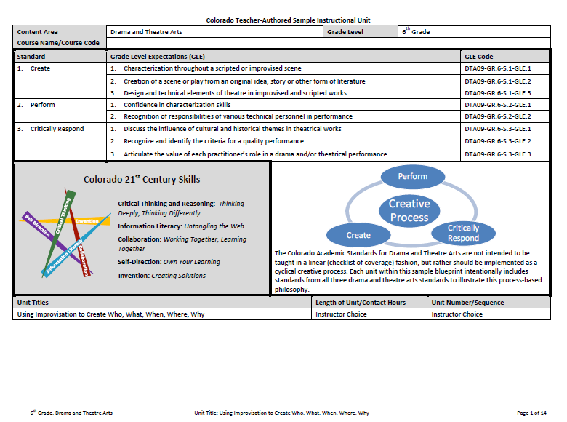
Curriculum Development Year at a Glance

Slide 14
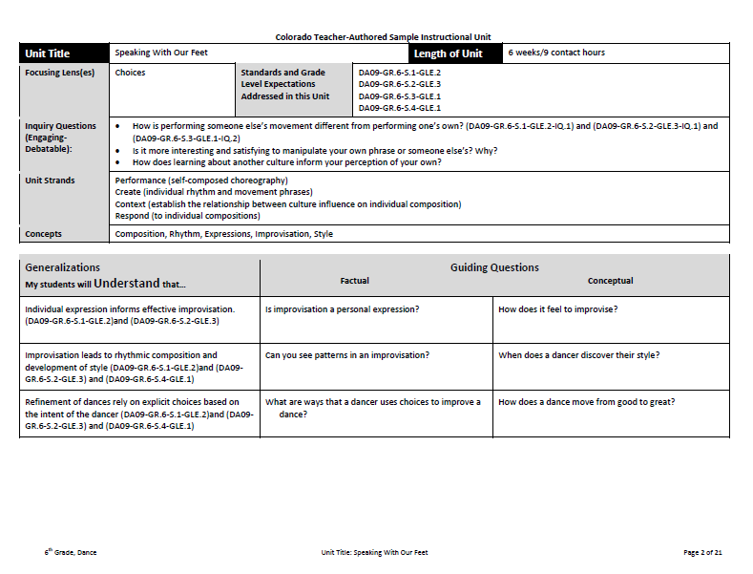
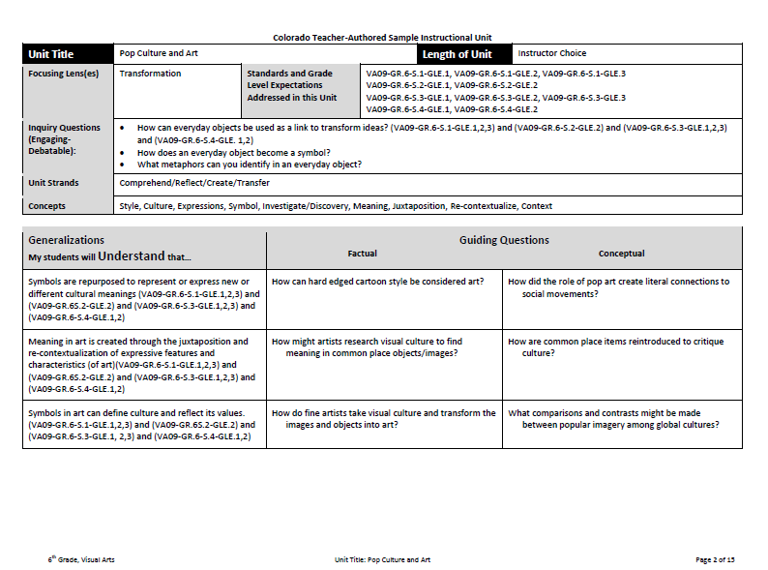
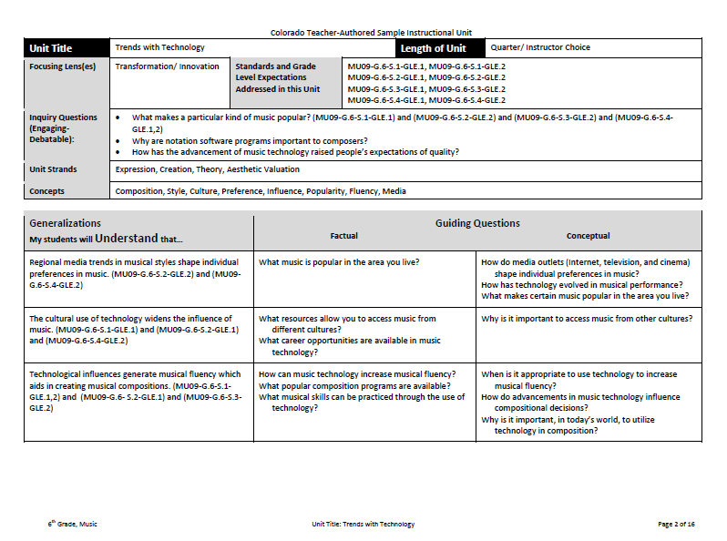
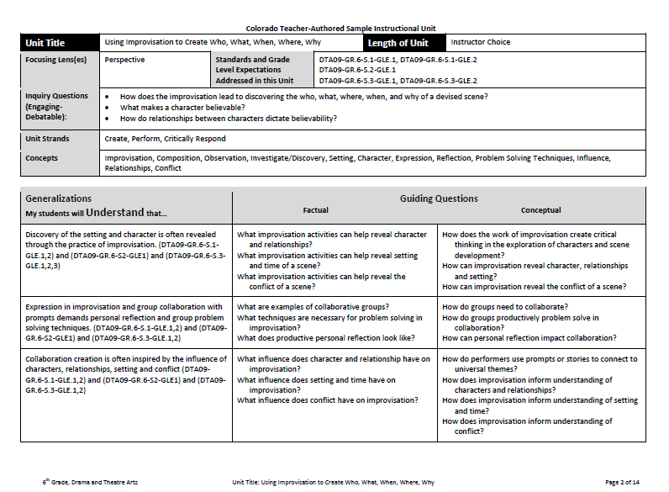

Slide 15
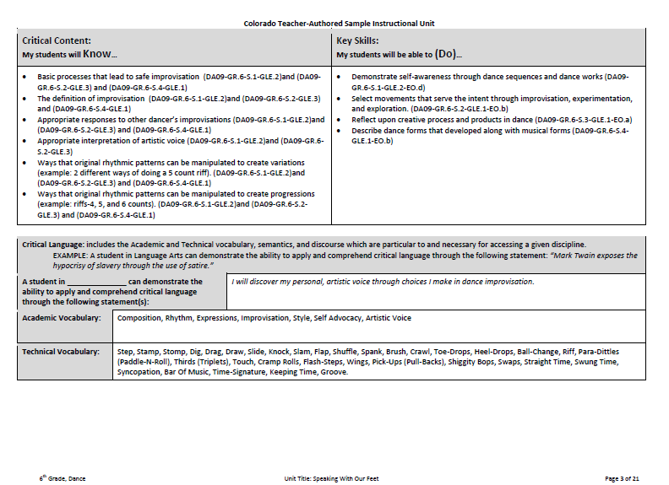
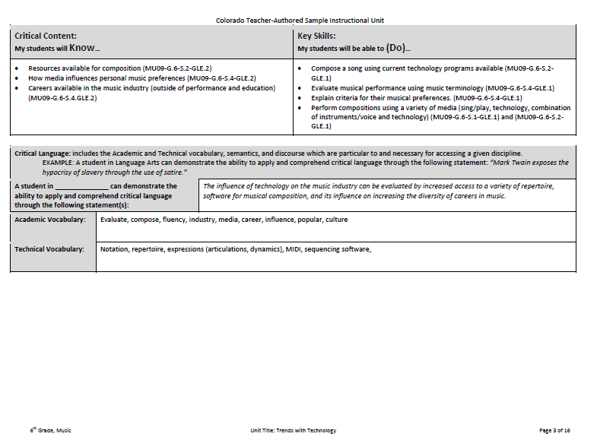
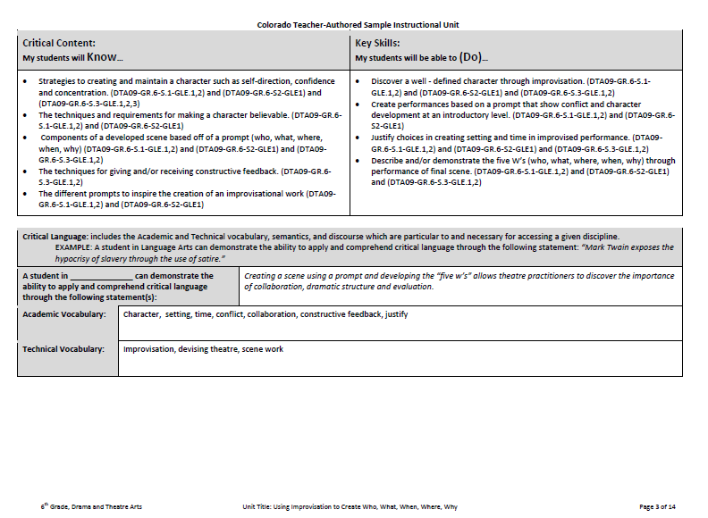
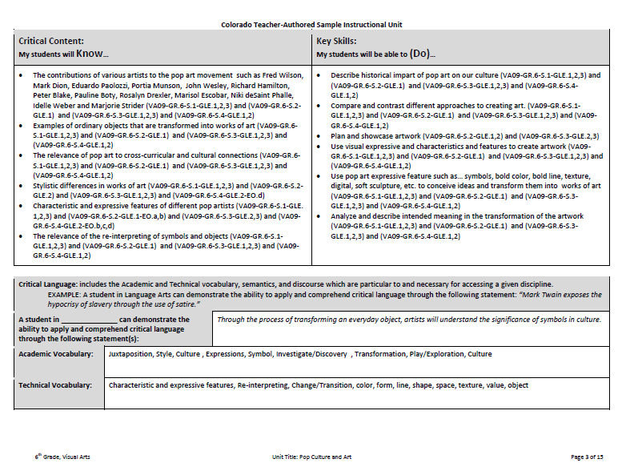

Slide 16
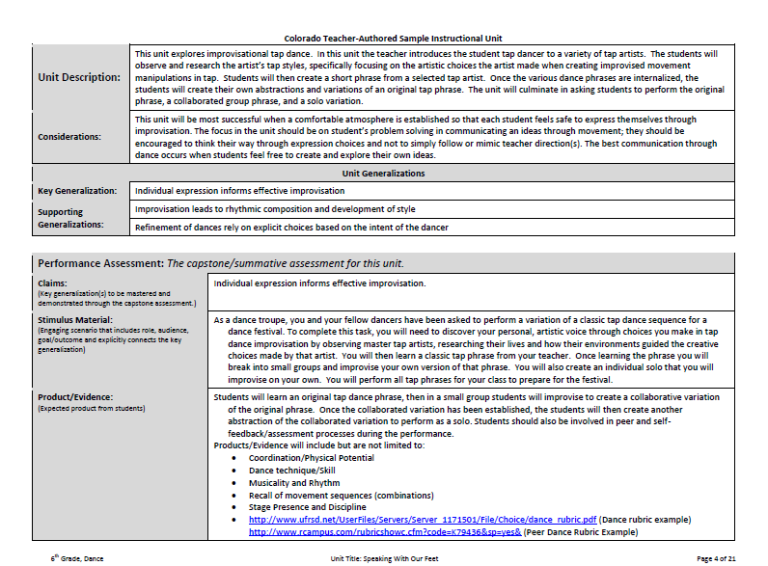
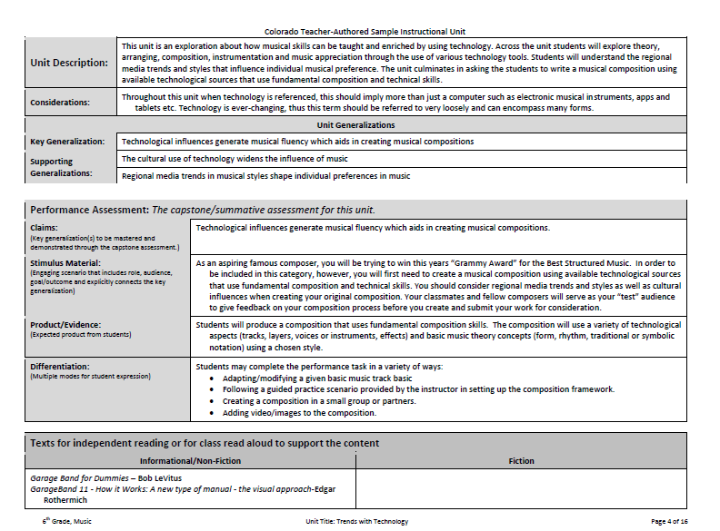
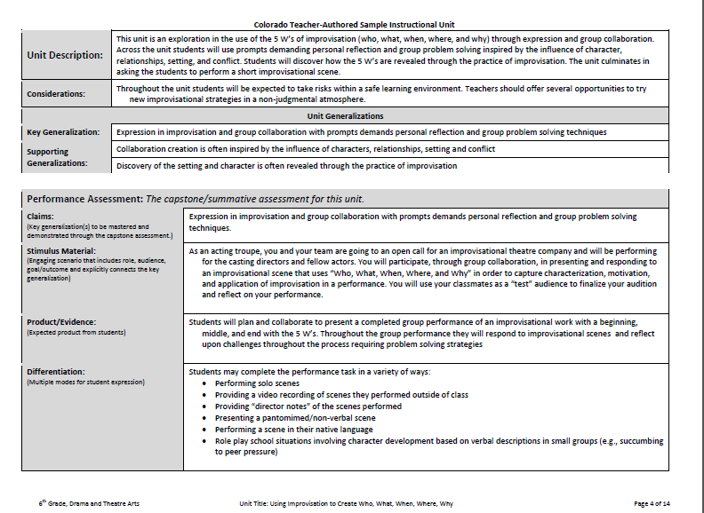
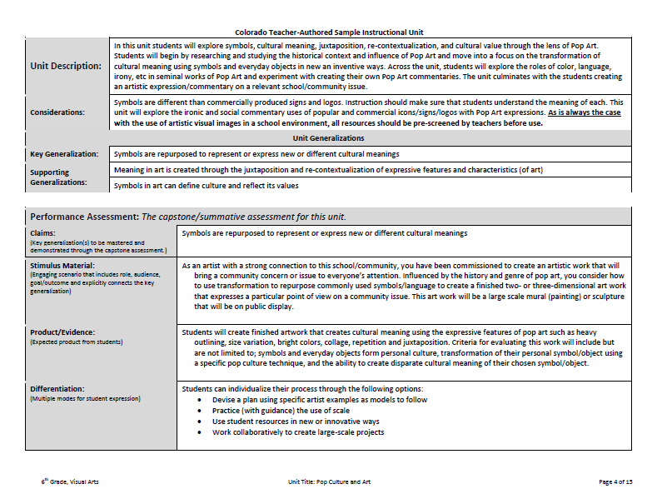

Slide 17
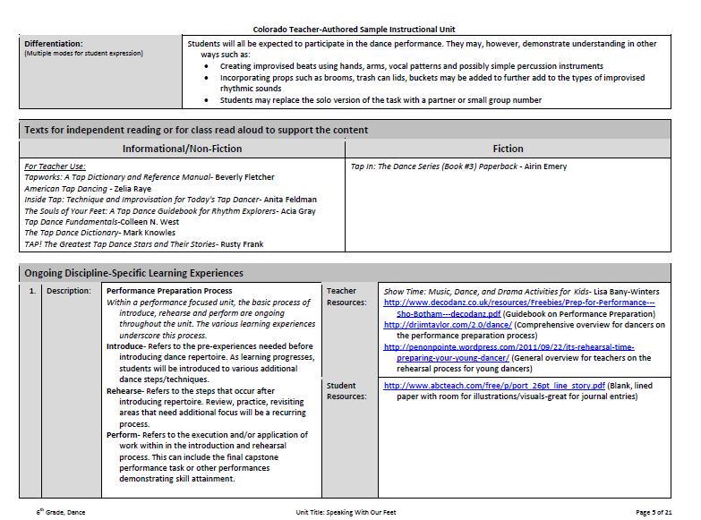
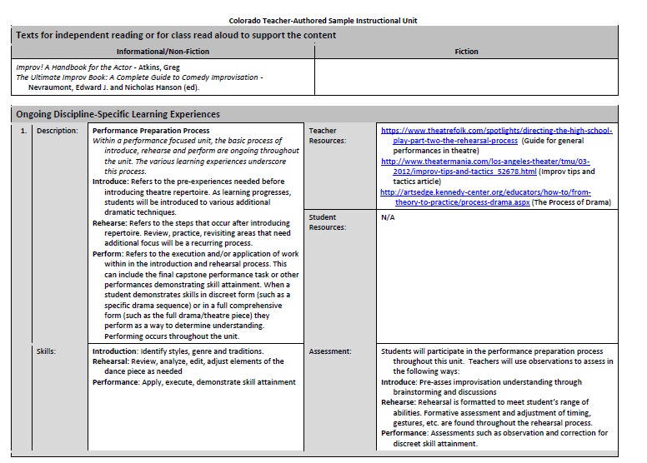
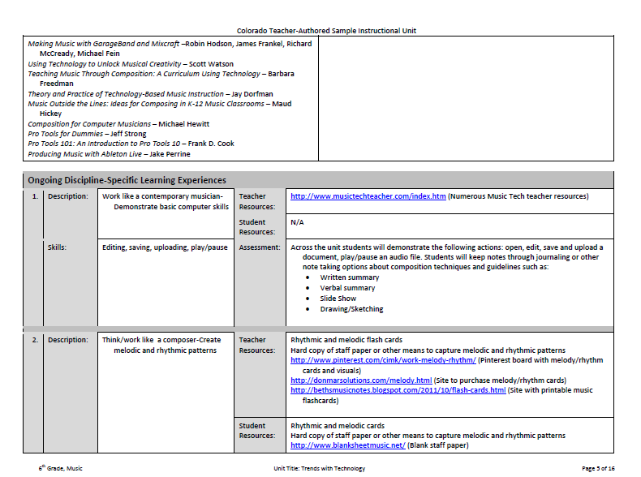
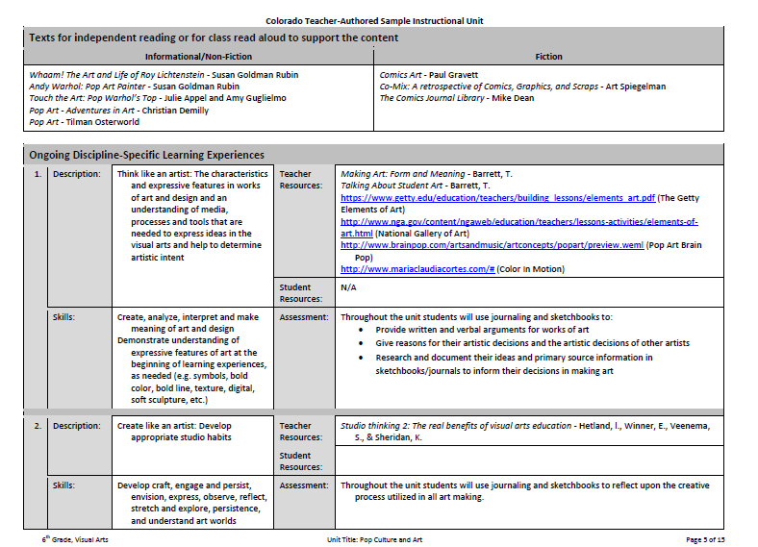

Slide 18
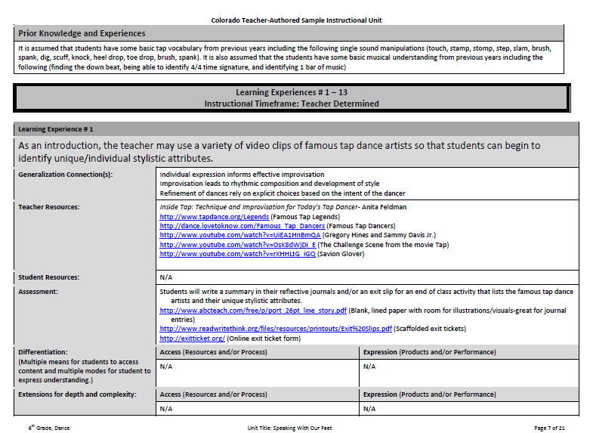
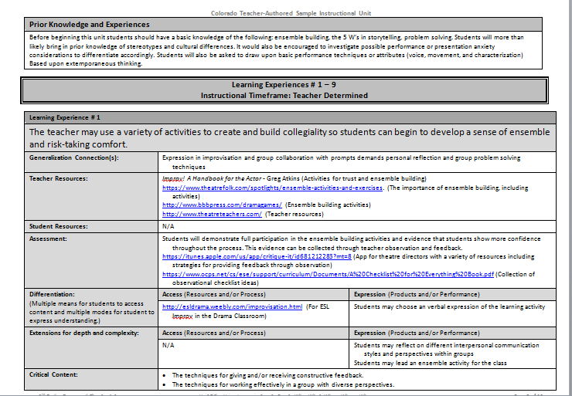
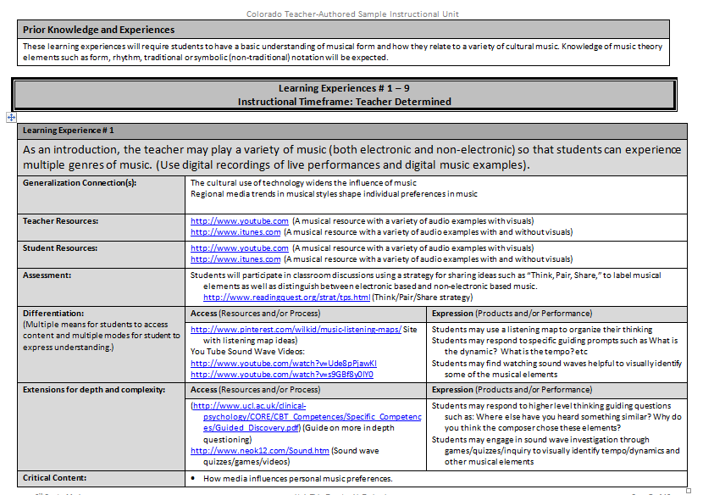
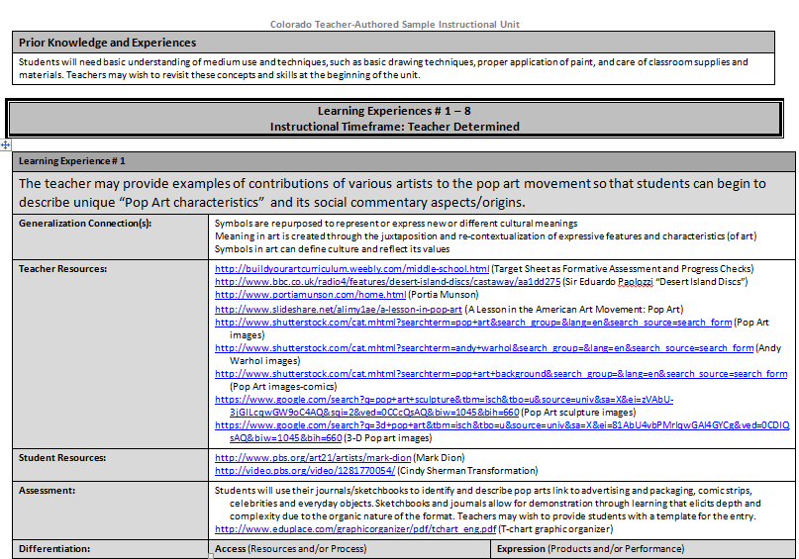

Slide 19
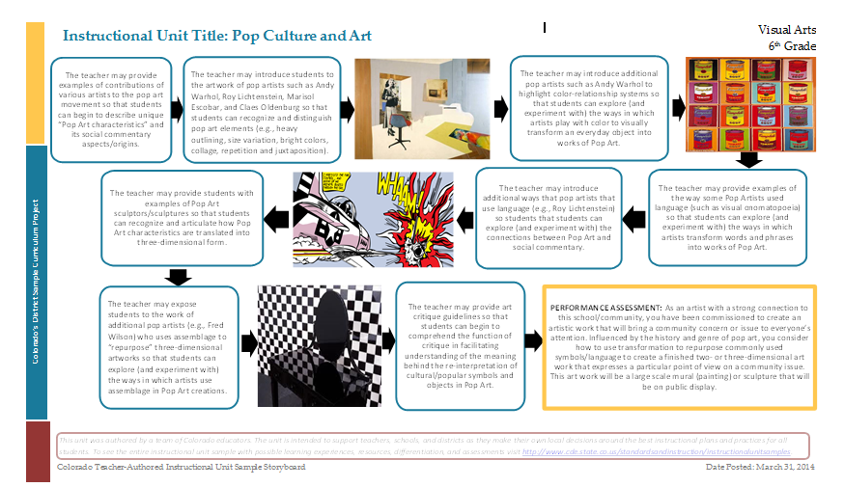
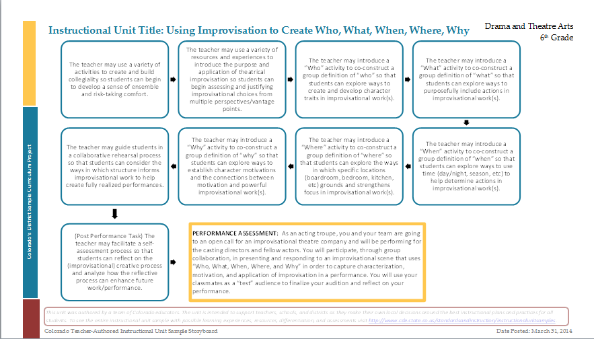
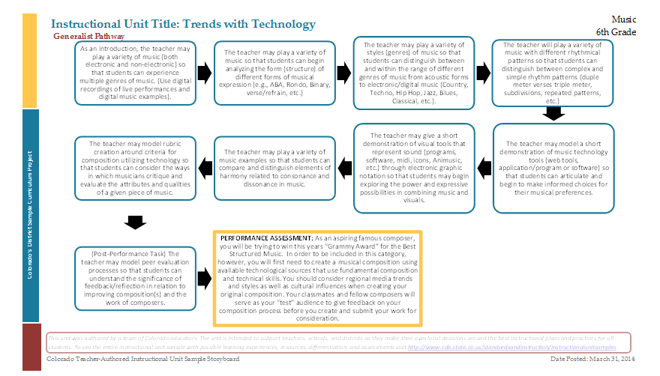
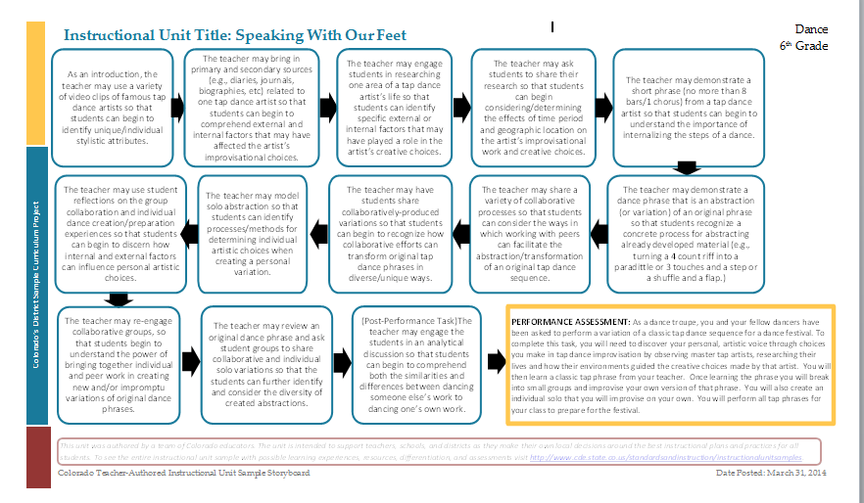
Learning Experience Story Board

Slide 20

“Points of Interest”
ASSESSMENT
Final Performance Task
  Underscores the natural performance elements in the arts disciplines
  Application of knowledge and skills is fundamental in an arts classroom
  Authors wrote performance tasks as a culmination of skills and concepts
Learning Experiences- Emphasis on Formative Assessment
  Natural way arts are assessed (in the moment, immediate feedback).
  Journaling, sketching and reflecting found throughout
  Not only is reflection and refinement a standard in all arts areas, it is a very strong formative/summative assessment tool.

Slide 21

Performance Assessment
An assessment based on observation and judgment. It has two parts: the task and the criteria for judging quality. Students complete a task (give a demonstration or create a product) and it is evaluated by judging the level of quality using a rubric.
Examples of demonstrations include playing a musical instrument, carrying out the steps in a scientific experiment, speaking a foreign language, reading aloud with fluency, repairing an engine, or working productively in a group. Examples of products can include writing an essay, producing a work of art, writing a lab report, etc. (Pearson Training Institute, 2011)

Slide 22
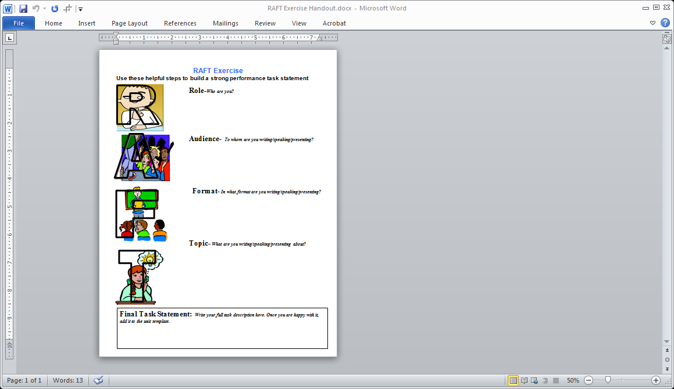
RAFT Exercise
An assessment strategy that helps students understand the role, audience, varied formats, and topics. By using this strategy, teachers encourage students to write/present creatively, to consider a topic form another perspective, and to gain practice writing/presenting to different audiences.
Notes:
We will be going into depth on each, but here is a brief overview

Slide 23
PA Example: Visual Arts
Performance Assessment: The capstone/summative assessment for this unit.
Claims: (Key generalization(s) to be mastered and demonstrated through the capstone assessment.) | Symbols are repurposed to represent or express new or different cultural meanings
Stimulus Material: (Engaging scenario that includes role, audience, goal/outcome and explicitly connects the key generalization) | As an artist with a strong connection to this school/community, you have been commissioned to create an artistic work that will bring a community concern or issue to everyone’s attention. Influenced by the history and genre of pop art, you consider how to use transformation to repurpose commonly used symbols/language to create a finished two- or three-dimensional art work that expresses a particular point of view on a community issue. This art work will be a large scale mural (painting) or sculpture that will be on public display.
Product/Evidence: (Expected product from students) | Students will create finished artwork that creates cultural meaning using the expressive features of pop art such as heavy outlining, size variation, bright colors, collage, repetition and juxtaposition. Criteria for evaluating this work will include but are not limited to; symbols and everyday objects form personal culture, transformation of their personal symbol/object using a specific pop culture technique, and the ability to create disparate cultural meaning of their chosen symbol/object.
Differentiation: (Multiple modes for student expression) | Students can individualize their process through the following options: Devise a plan using specific artist examples as models to follow Practice (with guidance) the use of scale Use student resources in new or innovative ways Work collaboratively to create large-scale projects
ROLE
TOPIC
FORMAT
AUDIENCE
RUBRIC/
SCORING CRITERIA
Notes:
We will be going into depth on each, but here is a brief overview

Slide 24
LE Example: Visual Arts
Students will use their journals/sketchbooks to identify and describe pop arts link to advertising and packaging, comic strips, celebrities and everyday objects. Sketchbooks and journals allow for demonstration through learning that elicits depth and complexity due to the organic nature of the format. Teachers may wish to provide students with a template for the entry.
http://www.eduplace.com/graphicorganizer/pdf/tchart_eng.pdf (T-chart graphic organizer)
Notes:
We will be going into depth on each, but here is a brief overview

Slide 25
“Points of Interest”
UNIQUE-TO-THE-CONTENT
Drama Theatre Arts and Dance
ELEMENTARY
Wrote for specialists but also classroom teachers (generalists) knowing that few schools have a specialist on staff
MS and HS
Began with foundational skills (improvisation/choreography) and progressively become more difficult
Drama Theatre Arts
HS example is only the Fundamental Pathway so teachers can build from that foundation, add in Extended Pathway requirements as needed without having to work from two documents
Dance
Almost always added an LE for a Post Performance Task experience for explicit reflective time

Slide 26
“Points of Interest”
UNIQUE-TO-THE-CONTENT
Music
Realized units of study are not as prevalent, especially after the elementary grades
Written from the perspective of getting ready for a concert - can be used as a concert planner
Included non- ensemble options to give support to music programs that do not focus on band, choir and/or orchestra

Slide 27
“Points of Interest”
UNIQUE-TO-THE-CONTENT
Visual Arts
Felt visuals were important in the storyboards
Looked at the LEs as a step by step model for honing in specific art making skills while underscoring the context, background and purpose for these skills
Utilized portfolios and sketching throughout grade levels
Media/Topics of study can be replaced with other foci-teacher choice

Slide 28

Thoughts? Feedback?
Please share any ideas/needs you have for additional webinar topics and/or trainings by email:
Gates_k@cde.state.co.us
Notes:
We will be going into depth on each, but here is a brief overview

Slide 29
Upcoming Webinars
Science Instructional Units April 22 @ 12:30 http://connect.enetcolorado.org/siu_science/
Comprehensive Health Instructional Units April 23 @ 12:30 http://connect.enetcolorado.org/siu_health/
Mathematics Instructional Units April 24 @ 12:30 http://connect.enetcolorado.org/siu_mathematics/
Social Studies Instructional Units April 25 @ 12:30 http://connect.enetcolorado.org/siu_socialstudies/

Slide 30
Thanks for joining us!

